Slide 1
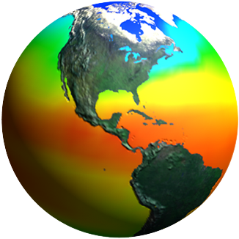
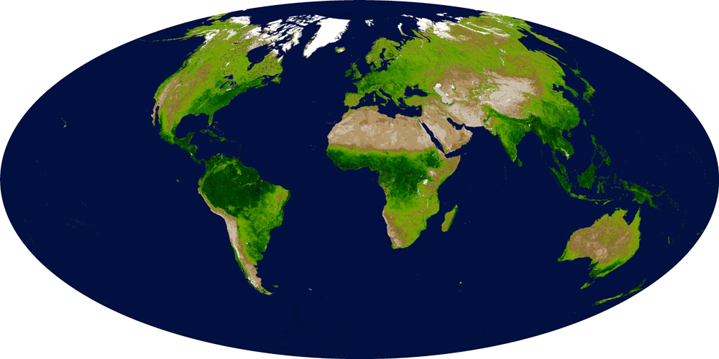
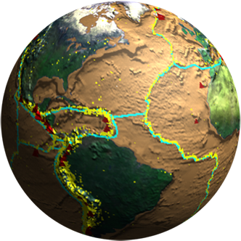
Biodiversity and Ecological Forecasting Team Meeting
Marriott Hotel and Conference Center, College Park, MD
Remote Sensing: Making Connections
Woody Turner
Earth Science Division
NASA Headquarters
April 22, 2015
Notes:
Introduce Allison, Maury, Jay, Cindy, and DEVELOP support.
The remote sensing-based work that you do is now central to biodiversity management and conservation.
It’s fun to reflect on the literature. In recent months, we have seen a remarkable synergy across works building on conservation biology theory and reinforcing the negative impacts of habitat loss on biodiversity while also emphasizing the importance of connectivity for maintaining terrestrial and marine biodiversity. One common denominator is the need for remote sensing in understanding change within large connected landscapes and seascapes.

Slide 2
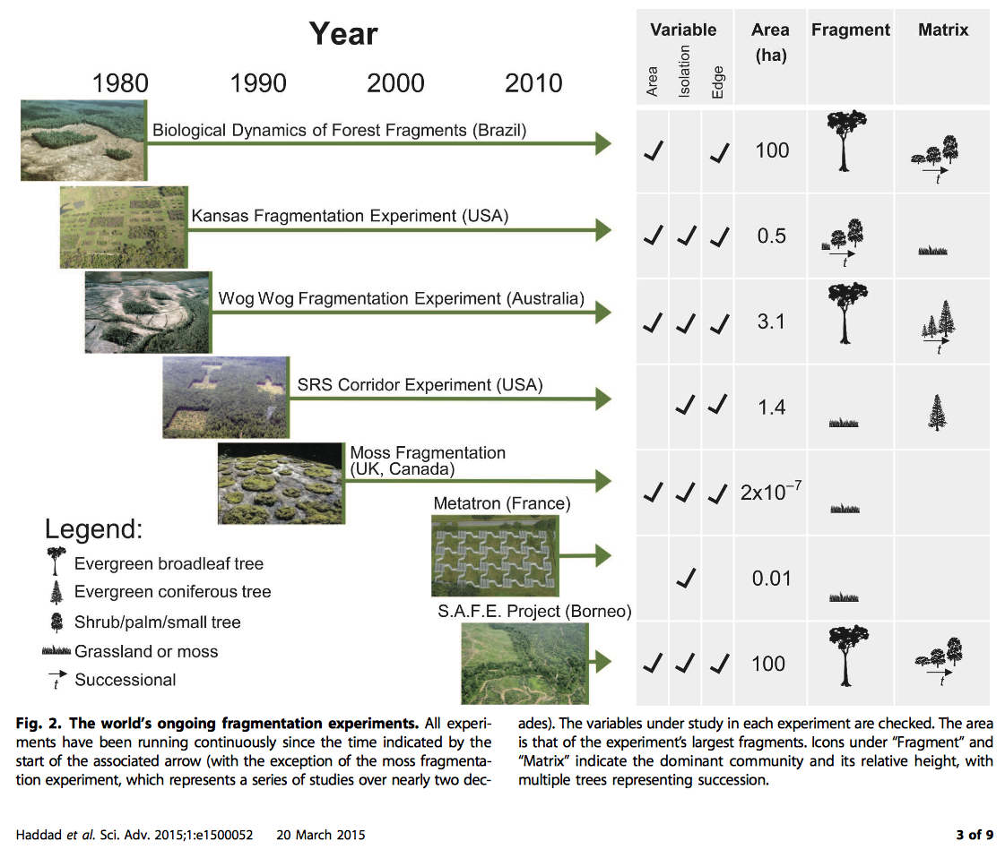
NASA Earth Science Missions
Current & Planned
Plus Earth Ventures
Notes:
Testing a classic theory of biodiversity change through large-scale and long-term experiments in forest systems.
We conducted an analysis of global forest cover to reveal that 70% of remaining forest is within 1 km of the forest’s edge, subject to the degrading effects of fragmentation. A synthesis of fragmentation experiments spanning multiple biomes and scales, five continents, and 35 years demonstrates that habitat fragmentation reduces bio- diversity by 13 to 75% and impairs key ecosystem functions by decreasing biomass and altering nutrient cycles. Effects are greatest in the smallest and most isolated fragments, and they magnify with the passage of time. These findings indicate an urgent need for conservation and restoration measures to improve landscape connectivity, which will reduce extinction rates and help maintain ecosystem services.
We analyzed the world’s first high-resolution map of global tree cover (13) to measure the magnitude of forest fragmentation. This analysis revealed that nearly 20% of the world’s remaining forest is within 100 m of an edge (Fig. 1, A and B)—in close proximity to agricultural, urban, or other modified environments where impacts on forest ecosystems are most severe (14). More than 70% of the world’s forests are within 1 km of a forest edge. Thus, most forests are well within the range where human activities, altered microclimate, and nonforest species may influence and degrade forest ecosystems (15). The largest contiguous expanses of remaining forests are in the humid tropical regions of the Amazon and Congo River Basins (Fig. 1A). Large areas of more disjunct forest also remain in southeastern Asia, New Guinea, and the boreal biomes.
Historical data enable the study of the process of forest fragmentation over time. We reconstructed the historical forest extent and timing of fragmentation in two forested regions of Brazil that provide a stark contrast in land-use dynamics. The Brazilian Amazon is a rapidly changing frontier (10), yet most of its forests remain contiguous and far from an edge despite recent increases in fragmentation (Fig. 1, C and D). In contrast, the Brazilian Atlantic Forest is a largely deforested landscape, cleared for agriculture and logged for timber over the last three centuries (11). This remaining forest is dominated by small fragments, with most fragments smaller than 1000 ha and within 1000 m of a forest edge (Fig. 1, E and F) (16). In the Brazilian Amazon, the proportion of forest farther than 1 km from the forest edge has decreased from 90% (historical) to 75% (today), and in the Brazilian Atlantic, from 90% to less than 9%.

Slide 3
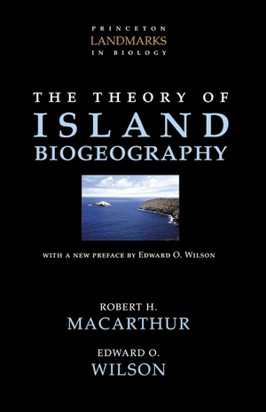
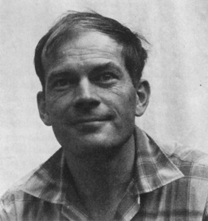
("Robert MacArthur" by Source. Licensed under Fair use via Wikipedia - http://en.wikipedia.org/wiki/File:Robert_MacArthur.jpg#/media/File:Robert_MacArthur.jpg)
Notes:
1967

Slide 4
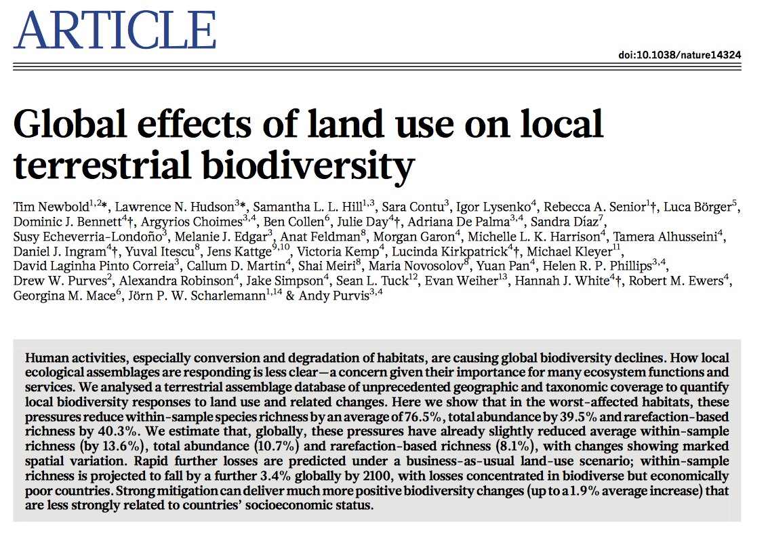

Slide 5
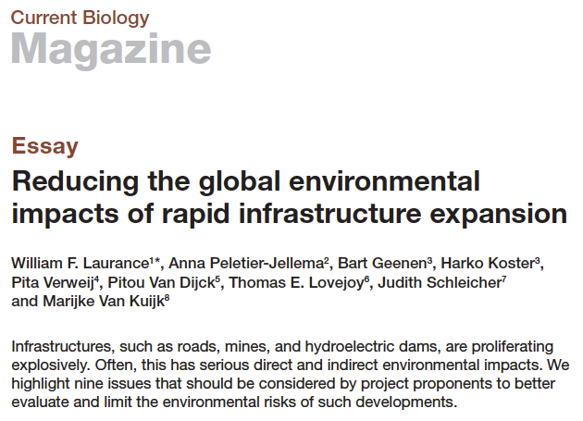
Drivers Are Increasing
Notes:
Might note the challenge of large development bank projects resulting from extensive funds available and the relative ease of managing a few large projects rather than several small ones—a development version of conservation biology’s SLOSS debate.

Slide 6
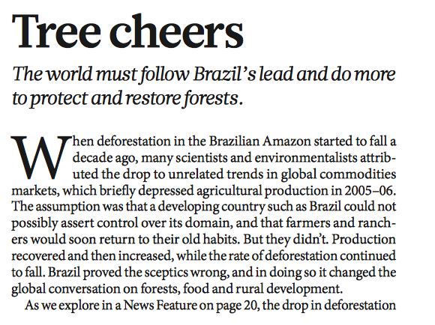
Advice from Nature
Notes:
Nature opines about the need for a Brazilian-like system that combines satellite forest monitoring, sustained law enforcement, NGO-fostered trade transparency (beef and soya), and new protected areas to reduce deforestation substantially.

Slide 7
Aichi Answers for 2020
Target 5
By 2020, the rate of loss of all natural habitats, including forests, is at least halved and where feasible brought close to zero, and degradation and fragmentation is significantly reduced.
Target 11
By 2020, at least 17 per cent of terrestrial and inland water, and 10 per cent of coastal and marine areas, especially areas of particular importance for biodiversity and ecosystem services, are conserved through effectively and equitably managed, ecologically representative and well connected systems of protected areas and other effective area-based conservation measures, and integrated into wider landscapes and seascapes.
Notes:
UNEP/IUCN/WCPA Protected Planet Report 2014:
Global protected area coverage (Chapter 2): About 209,000 protected areas (PAs) cover 15.4% of the planet’s terrestrial and inland water areas, and 3.4 % of the oceans. 8.4% of all marine areas within national jurisdiction (0-200 nautical miles) are covered protected areas while only 0.25% of marine areas beyond national jurisdiction are protected. In total, 2.2 million square kilometres of land and inland water areas and 2.2 million square kilometres of marine area within national jurisdiction will need to be designated as protected areas to cover 17% of the land and 10% of the marine and coastal areas.

Slide 8
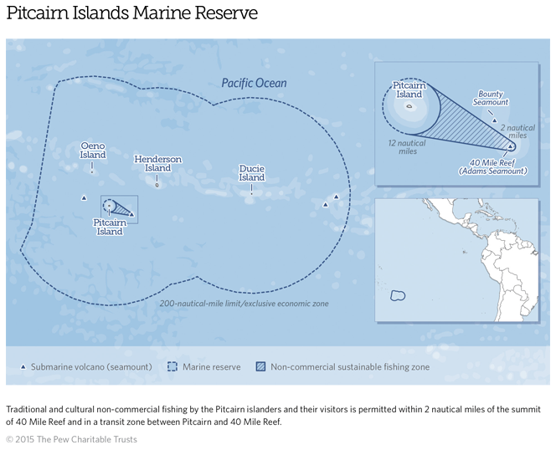
Notes:
834,334 square kilometer/322,138 square mile reserve = ~3.5x the size of the UK
Pitcairn Islands joins a growing list of very large marine reserves involving varying degrees of protection and including the Coral Sea (France and Australia), Pacific Remote Islands (USA), South Georgia Marine PA (UK), Chagos (UK), Phoenix Islands (Kiribati), Papahānaumokuākea (USA), Great Barrier Reef (Australia), etc.
The State Department is working with Pew, NOAA, NASA, and others to design an observational enforcement regime for very large MPAs—tie to Marine BONs??

Slide 9
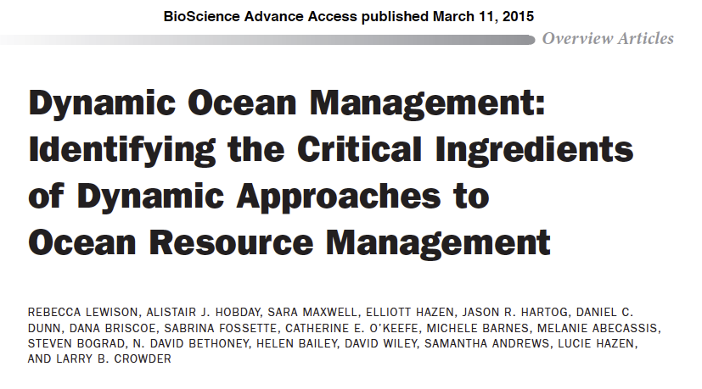
Managing in Time as well as Space
Notes:
Dynamic ocean management, or management that uses near real-time data to guide the spatial distribution of commercial activities, is an emerging approach to balance ocean resource use and conservation. Employing a wide range of data types, dynamic ocean management can be used to meet multiple objectives—for example, managing target quota, bycatch reduction, and reducing interactions with species of conservation concern. Here, we present several prominent examples of dynamic ocean management that highlight the utility, achievements, challenges, and potential of this approach. Regulatory frameworks and incentive structures, stakeholder participation, and technological applications that align with user capabilities are identified as key ingredients to support successful implementation. By addressing the variability inherent in ocean systems, dynamic ocean management represents a new approach to tackle the pressing challenges of managing a fluid and complex environment.
Terrestrial analogues: migrations, fruiting periods, etc.

Slide 10
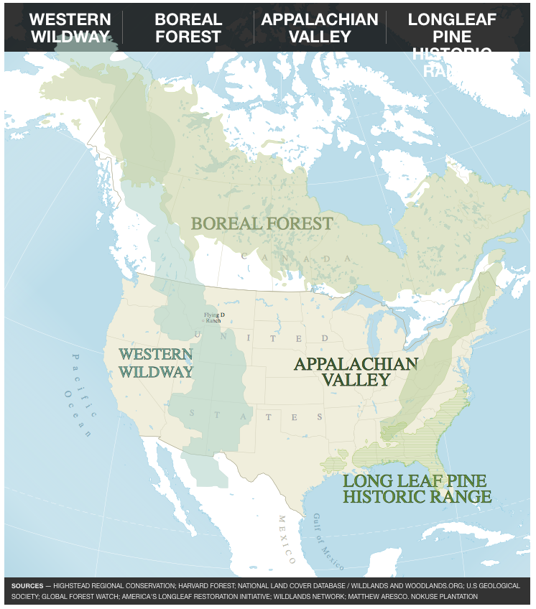
Wilson’s Answer: Give Nature Half
(from Tony Hiss, Smithsonian Sept. 2014)
Notes:
“Boxing America” through natural corridors
Wilson calls for setting aside 50% of land surface and 50% of ocean surface for nature. He cites the declining rate of human population growth, the flow of people from rural to urban environments, improvements in currently “Neolithic” food production output, and reduction in the human ecological footprint due to the digital evolution’s driving down the use of materials and energy to develop products (going from extensive to intensive economic growth that is much less land-based).
Best response to climate change
40 species of snakes in the central Gulf region and more turtle species there than anywhere in the world

Slide 11
Connectivity Is Key
Nature Climate Change article by Jantz, Goetz and SERVIR AST PI Nadine Laporte reveals that focusing on biological corridors through REDD+ activities could both maintain tropical landscapes and benefit biodiversity, even in the face of increased land use and climate change.
Used high-res vegetation carbon stock data derived from MODIS and GLAS datasets to map corridors traversing areas of highest biomass between tropical protected areas.
Results:
Many corridors have carbon densities equal to or above that of protected areas they connect.
As pathways for movement of mammalian populations to alternate habitat, corridors also mitigate the effects of land use and climate change on biodiversity.
These results can inform REDD+ planning in developing countries and help integrate climate mitigation and biodiversity goals.
Corridors are shown in white, protected areas in semi-transparent grey, and biomass as a gradient from low density in red to high density in green.
|‌ 11
Notes:
Paper published in Nature Climate Change: Patrick Jantz, Scott Goetz and Nadine Laporte. Carbon stock corridors to mitigate climate change and promote biodiversity in the tropics. 2014. Nature Climate Change, http://dx.doi.org/10.1038/NCLIMATE2105
A vegetation carbon stock biological corridor is a habitat area that serves as a pathway between protected areas.
REDD+ = Reducing Emissions from Deforestation and Forest Degradation. It is a carbon finance mechanism discussed under the United Nations Framework Convention on Climate Change (UNFCCC) to effectively decrease forest-based CO2 emissions, which account for 10-25% of annual emission. Tropical countries will receive funds in proportion to their effort to reduce their emissions or enhance their carbon stocks and identify and finance incentives to lead to low-carbon paths to sustainable development. "REDD+" goes beyond deforestation and forest degradation, and includes the role of conservation, sustainable management of forests, and enhancement of forest carbon stocks.
Map shows central Africa.
Biomass was estimated as a function of MODIS Nadir Bidirectional Reflectance Distribution Function Reflectance (NBAR), temperature, and SRTM elevation (Described in Baccini et al, 2012 in Nature CC)
MODIS (Moderate Resolution Imaging Spectroradiometer)
SRTM (Shuttle Radar Topography Mission)

Slide 12
Observe Like We Already Have a Box
Understanding biodiversity change in the face of global anthropogenic drivers and conserving it for the future both require the use of a growing array of remote sensing technologies.
It’s time to build integrated systems to observe biodiversity at large scales for understanding and conservation.
Ecological connectivity is key to assembling large regions for nature and allowing corridors for movement of organisms responding to a changing environment.
So, what would integrated global-to-local (i.e., top down and bottom up) biodiversity observation and monitoring networks supporting large connected landscapes and seascapes look like?
Let’s discuss tomorrow.
Notes:
Wilson supports “Boxing America”

Slide 13
Thank You

